Slide 1

We would like to increase our ability to predict whether a home will sell above median price
Age and style of house, number of full baths, neighborhood, year of remodel, overall house quality - there are many variables that hold high predictive value. Modeling will help us understand our variables' predicitive value.

Slide 2
Three Models
In our goal to predict a home sale as above median or below median, we looked at a dataset with 81 variables and 2053 property sales over the period from 2006-2010. After visualizing our dataset, I pared down the dataset by selecting the 20 variables that seemed to have high predictive value. Then I split the data into two parts: a training set holding 70% of the data and a testing set holding 30%.
I built three kinds of predictive models:
Random Forest
Logistic Regression
Classification Tree

Slide 3
Random Forest Results
612 house sales in our testing set
1525 house sales in our training set
Training set: Testing set:
Confusion Matrix
Prediction No Yes
No 692 18
Yes 15 700
Accuracy : 0.9768
95% CI : (0.9676, 0.984)
No Information Rate : 0.5039
P-Value [Acc > NIR] : <2e-16
Sensitivity : 0.9749
Specificity : 0.9788
Confusion Matrix
Prediction No Yes
No 289 37
Yes 14 272
Accuracy : 0.9167
95% CI : (0.8919, 0.9373)
No Information Rate : 0.5049
P-Value [Acc > NIR] : < 2.2e-16
Sensitivity : 0.8803
Specificity : 0.9538
Accuracy drops off from training to testing and this can be expected
With the testing set, sensitivity drops to 88% for identifying above median sales​. In other words, the above median "yes" results are true 88% of the time.
Sensitivity indicates that this model is 97% true when identifying a yes for above median sales

Slide 4
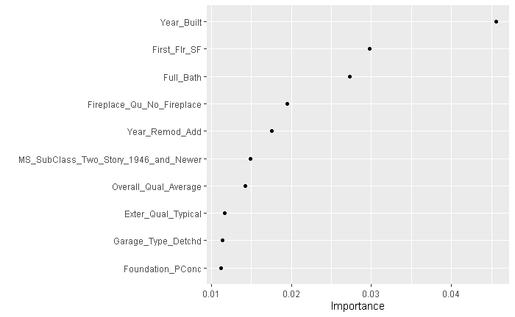
Our random forest model tells us that these are the 10 variables with the highest prediction value
One weakness of this model is that variables with many parts, like our neighborhood variable, gets left off this list because each neighborhood is considered on it's own. No one neighborhood is important enough, in contrast to these 10 variables, to make this list. Neighborhood is still a powerful predictor, but it is not on this list.

Slide 5
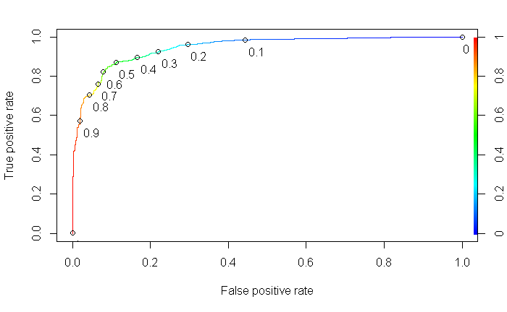
Logistic Regression Results
I built a logistic regression model with 4 variables that are strong predictors: full bath, year of remodel, overall quality and first floor square feet. These were listed in the previous slide as 4 of the top 10 predictors identified by the random forest model.
The area under the curve (AUC), which is a measure of the strength of this LR model, is .944.
Logistic regression will identify some individual parts of variables as significantly correlated with the response variable and LF identifies the direction of correlation: positive or negative.
Full_Bath
Year_Remod_Add
First_Flr_SF
Overall_Qual_Average (negative correlation)
Overall_Qual_Below_Average (negative correlation)
Overall_Qual_Good
Overall_Qual_Very_Good
Significant correlations

Slide 6
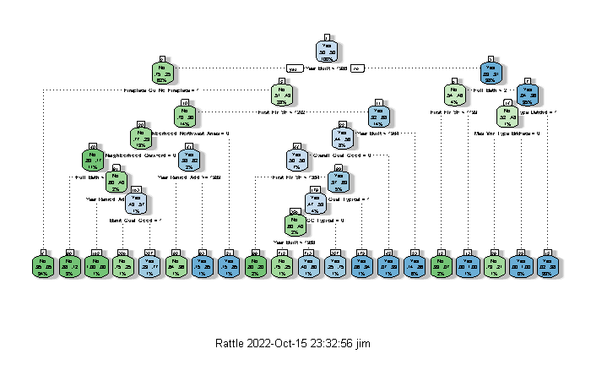
Classification Tree Results
This tree gives us an .925 accuracy rate. This classification tree has a significant P-value for the model vs naiive. In this balanced data set the naiive is nearly .50.
Full bath =2

Slide 7
In summary, our three models were given the same training and testing data and performed as follows:
Random Forest performed at .977 accuracy on the training set and .917 accuracy on the testing set.
Logistic Regression showed area under the curve on the training set .944 and .953 on the testing set.
Classification tree gave us a .925 accuracy rate on the training set and .889 on the testing set.

